Slide 1

Lecture 9
Chemical Engineering for Micro/Nano Fabrication
157 nm

Slide 2
157 nm Lithography
F₂ Excimer Laser output 157 nm
157 nm light
  Air, water, polyethylene…almost everything is opaque
  CaF₂ is transparent but crystalline, birefringent
  There is no resist, no Mask material, no Pellicle, immersion Fluid, etc.
Requires a New Infrastructure
  Glass, purge gas. Mask…. Long lead times and EUV is coming ☺

Slide 3
Absorption (μm⁻¹) of Common Polymers
Transmission
0.00001%!!!
Wavelength (nm)
157.6 193 248
248 resist 6.84 0.37
193 resist 6.86 0.47
Polystyrene* 6.20
Polynorbornene* 6.10
PMMA* 5.69
Fluorocarbon* 0.70
Vacuum UV
O₂, H₂O absorbs at this wavelength
Even hydrocarbons like butane and polyethylene absorb strongly
* R.R.Kunz,et al., Proc. SPIE 3678, 13 (1999).

Slide 4
Fluorination of Norbornane Skeleton
Opaque
Transparent
?
?
248 nm
193 nm
157 nm
How many fluorines and where to fluorinate?

Slide 5
Selective Fluorination of Norbornane
Geminal substitution at the two carbon bridge is the most effective fluorination pattern
α-CF₃ acrylates

Slide 6
Surprising Serendipitous Discovery
Originally for Top Surface Imaging Project
A₁₅₇ = 2.57 μm⁻¹
A₁₅₇ = 1.15 μm⁻¹
NBHFABOC and NBHFA are surprisingly transparent
T. Chiba, et. al., J. Photopolym. Sci. Technol , 13 (2000) 657-664

Slide 7
Absorbance of Fluorinated Polymers
(2.68 μm⁻¹)
(5.42 μm⁻¹)
(6.02 μm⁻¹)
(2.44 μm⁻¹)
(1.15 μm⁻¹)
Hexafluoroisopropyl and α-trifluoromethylcarboxylic acid
are groups surprisingly transparent!

Slide 8
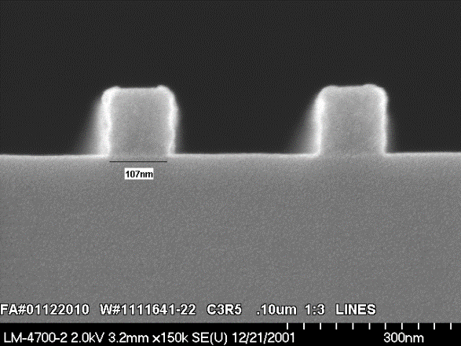
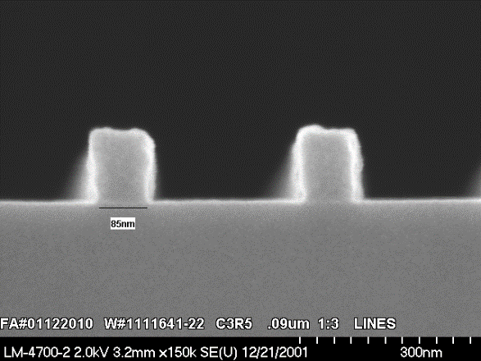
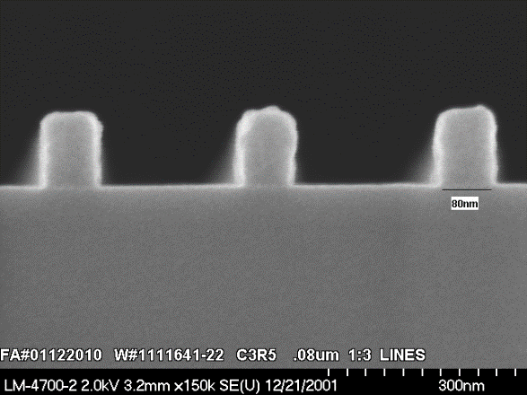
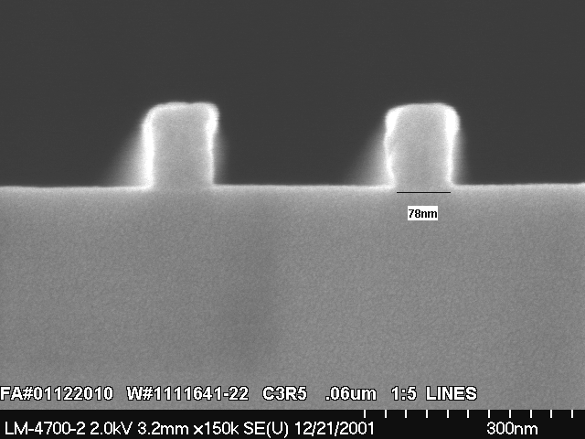
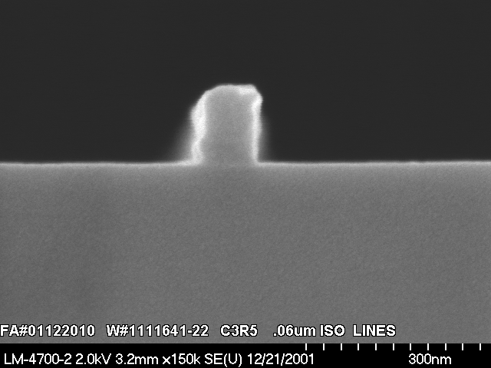
Encouraging Imaging Results at 157 nm
100nm
90nm
80nm
60nm
40nm

Slide 9

Resist and Process Development
Basic
Chemistry
Formulation and Process Development
Optimization
I-line
248nm
Performance
60nm
157 nm
193nm
We are well off the base line
Time

Slide 10
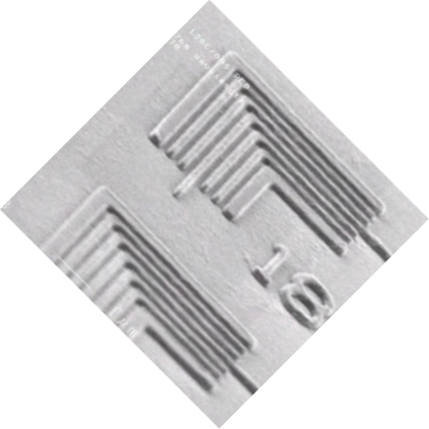
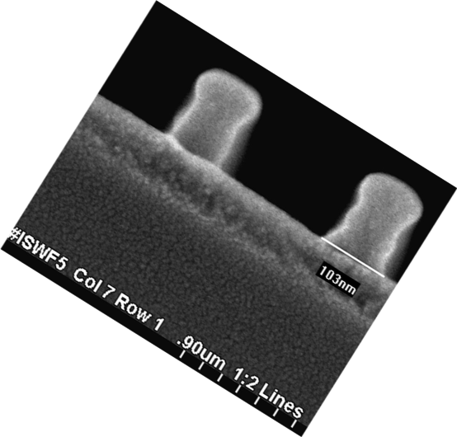
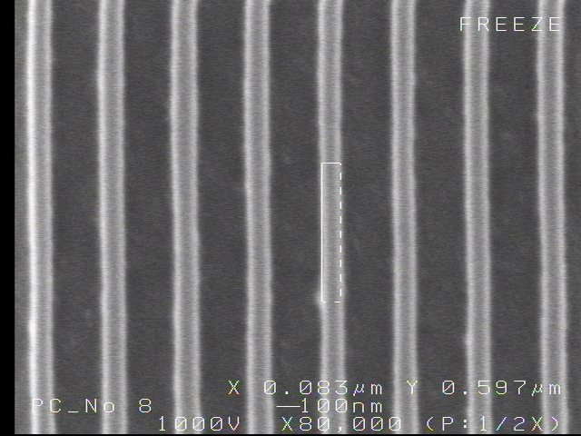

Images in UT 157nm Resists
70nm
Intel Announcement
Issues include: Pace, Resist, Pellicles, CaF₂, Birefringence, Cost, etc.
85nm
60nm
90nm

Slide 11

The Kiss of Death
intel drops 157-nm tools from lithography roadmap
Mark LaPedus
5/23/2003 01:40 AM EDT
SANTA CLARA, Calif. -- Intel Corp. has revised its lithography strategy for the second time in the recent months, disclosing it has dropped 157-nm tools from its roadmap and is not pursuing the scanner technology for IC production. The move is expected to impact fab-tool and material vendors developing 157-nm products for Intel.
El beso de la muerte, by an unknown sculptor.
Barcelona, Spain ca. 1930

Slide 12
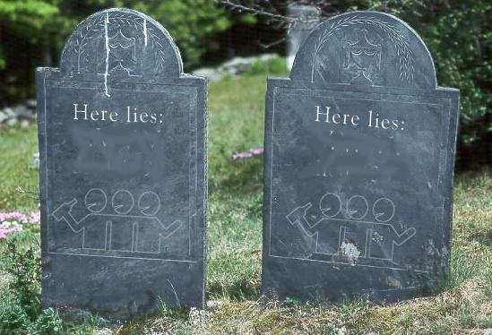
The Landscape is littered with NGL’s
Electron Beam direct write
Write with many electron beams
Project electron beams
All of the above with ions
Shadow printing with Synchrotron X-rays
Now here lies 157nm …rest in peace!
157nm
X-ray
157nm
X-ray

Slide 13
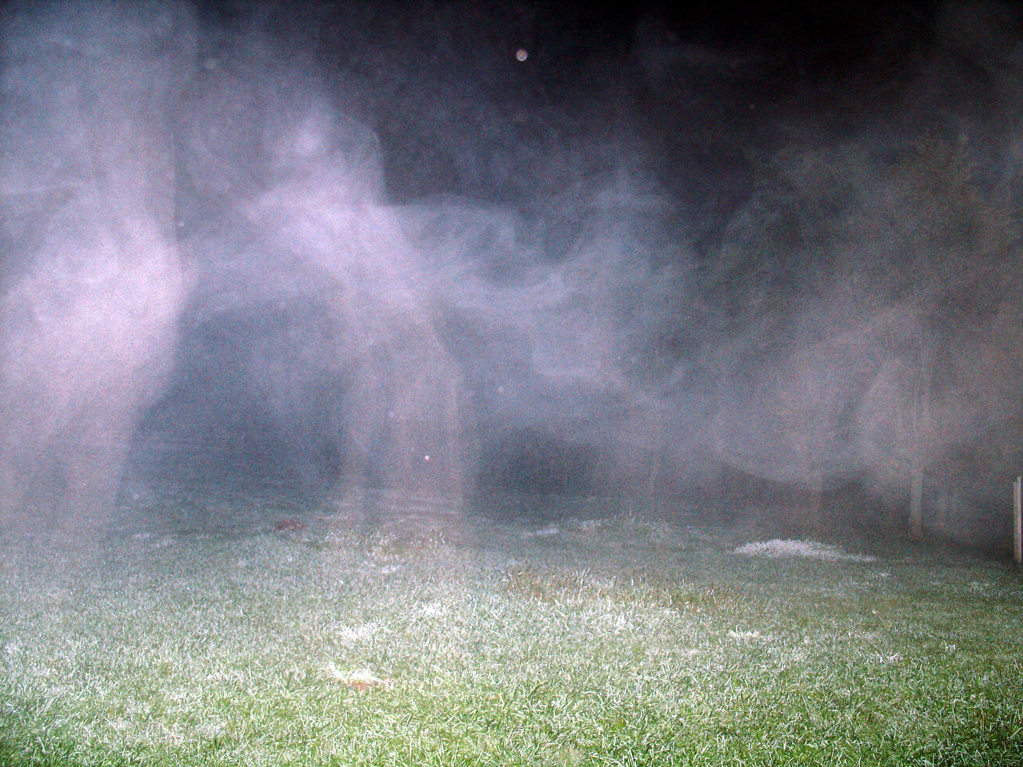
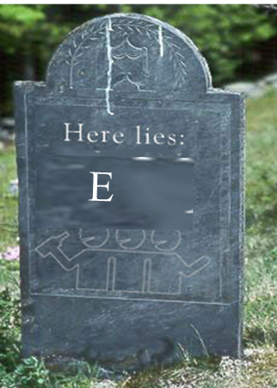
Let’s look more closely in the graveyard
157nm
X-ray
X-ray

Slide 14
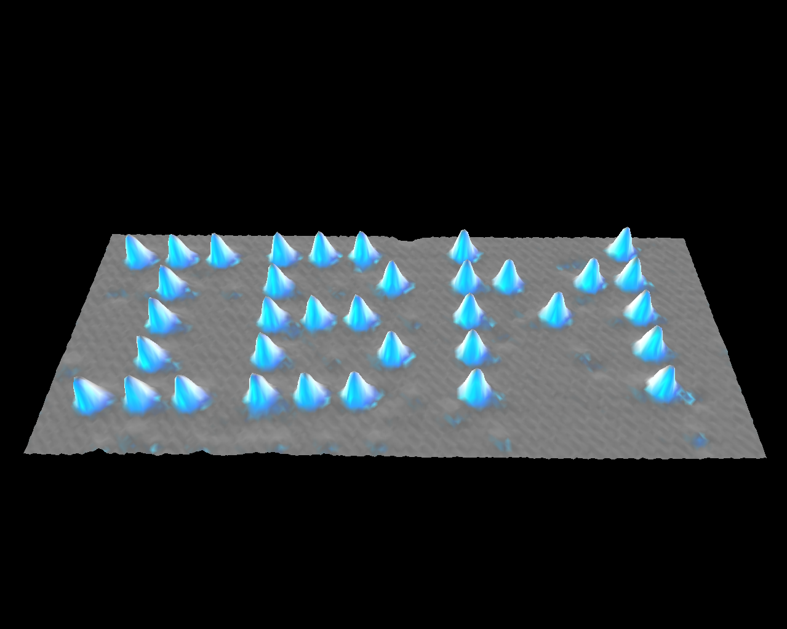
Ultimate limit of high resolution patterning!!
1 atom
0,438 nm
Eigler, et al IBM Almaden
Xe on Nickel
Notes:
There is a limit to resolution and this is it…one atom

Slide 15
Consider Resolution vs. Throughput
Shaped & cell projection E-beam lithography
Other Gaussian E-beam lithography (high speed resists)
AFM (single tip with Silicon as resist)
Resolution (Angstrom)
E-beam lithography
(inorganic resists)
Gaussian E-beam lithography
(PMMA resist)
Imprint
←STM- atom manipulation
10⁻⁶
10⁻⁴
10 ²
10⁴
10¹²
10⁻²
10⁰
10⁶
10⁸
10¹⁰
Don Tennant: Cornell University
Area Throughput (μm²/hr)
Notes:
This plot from Professor Tennant at Cornell shows that all high resolution printing methodologies fall on a line in a log-log plot that relates throughput to resolution. The single atom experiment is in the lower left….very slow, but high resolution. Optical lithography I in the upper right. There is one technique that does not fall on this line. That is imprint so we were inspired to explore this technology.

Slide 16
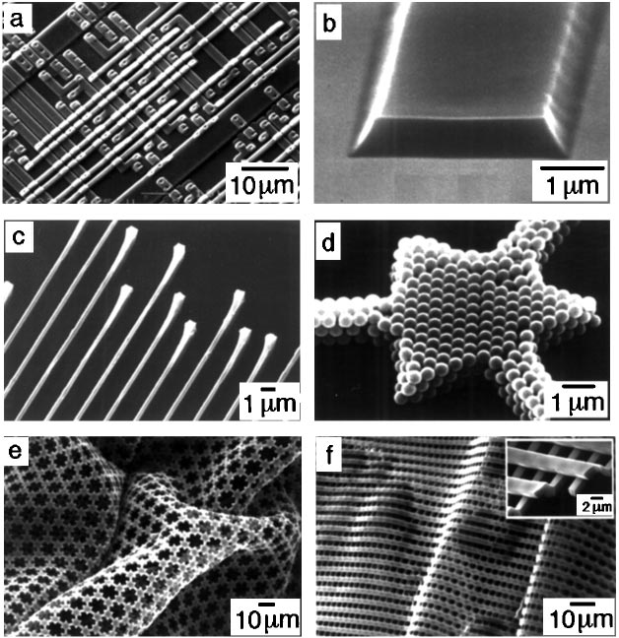
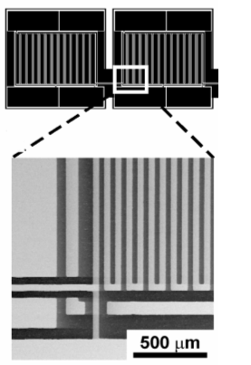


90’s Soft Lithography
Soft Lithography
1. PDMS template with thiol
2. Imprint stamp
3. Transfer molecules
4. Pattern Transfer
Younan Xia and George M. Whitesides
Annu. Rev. Mater. Sci. 1998. 28:153–84

Slide 17
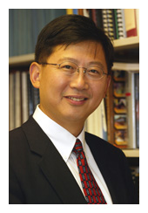
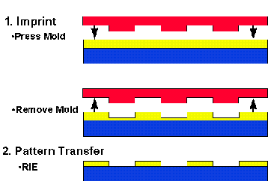
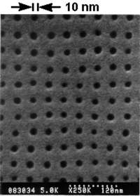
90’s Thermal Imprint Lithography
NIL Process
Science 5 April 1996:
Stephen Y. Chou, * Peter R. Krauss, Preston J. Renstrom
Imprint Lithography with 10 -Nanometer Resolution

Slide 18
Pattern Density Effects
Easiest… Easy… Very Difficult!
“Residual layer”

Slide 19
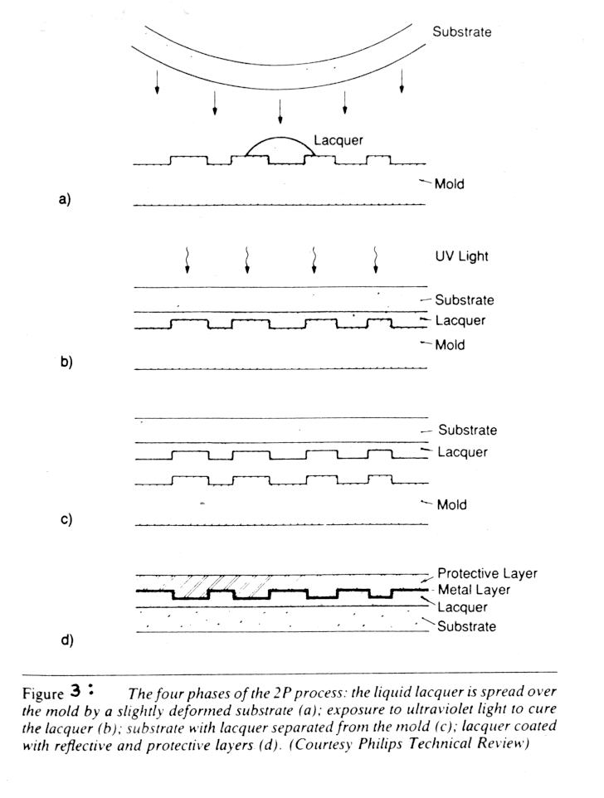
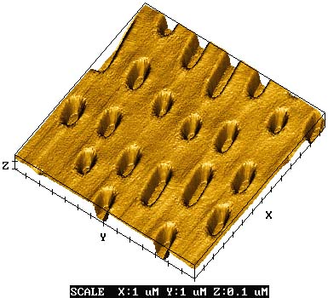
1980’s Nanoimprint for CDs
Phillips 2P process
  UV sensitive “lacquer” sandwiched between mold and thin polycarbonate substrate
  UV light shown through substrate to cure lacquer

Slide 20

2000 Step and Flash Imprint Lithography
Fused silica template, coated with release layer
S-FIL fluid dispenser
Ink jet system
Template
Step 1: Dispense drops
Planarization layer
Substrate
Step 2: Lower template and fill pattern
Template filling driven by capillary action
low imprint pressure and room temperature process
Template
Planarization layer
Substrate
Step 3: Polymerize S-FIL fluid with UV exposure
Planarization layer
Substrate
Step 4: Separate template from substrate
Template
Step & Repeat
Planarization layer
Substrate
Notes:
So how does the technology work. Well before I go into the details of SFIL, lets talk about imprint technology in general. It had its genesis I suppose with the wax seals that the Chinese invested to authenticate documents, and the same thermoplastic process has been used in the past decade to make very high resolution lithography patterns – with Stephen Chou at Princeton leading the way. However, any thermal process is an absolute non starter in the CMOS industry since it makes accurate overlay impossible. The next alternative was to use a UV curable film spun onto the wafer, but now you have the challenge of moving a relative high viscosity material between the various patterns on the template, so Grant and SV came up with the idea of using a low viscosity monomer placed on the surface of the wafer.
This slides shows a schematic animation of the SFIL process:
Points to make – template is common with photolithography – smaller dimensions yes, but otherwise common to allow commercial supply – no membranes per previous NGL efforts
- process leaves a very thin film which can be removed in an etch descum. ie the process is compatible with etch. Thus the upstream template and the down stream etch and compatible. Just replace the litho cell.
- some application are whole wafer

